Slide 1

Loryne Muthoni’s Autobiography

Slide 2
Agenda
Early Life and Family Background
Education and Academic Journey
Personal Growth and Development
Career and Professional
Achievements Challenges and
Adversities
Passions, Hobbies, and
Interests Relationships and
Friendship Identity and
Cultural Background

Slide 3

Early Life and Family
Background
Key Highlights
Born on February 17, 2003, in Chogoria Mission Hospital, Meru County.
Youngest member of the Mburu family, my parents are Jane Wanjiru and Paul Mburu.
Close bond with my two older sisters, Evelyne Wanjiku and Petra Wangeci.
Our family values are rooted in faith, hard work, and integrity.
We moved from Embu to Umoja due to a traumatic incident, later settled in Utawala and Kitengela.

Slide 4



Education and Academic Journey
Preschool and Kindergarten
My educational journey began at Little Scholars Preschool and Kindergarten in Umoja, where I took my ﬁrst steps into formal education.
Primary School
At Mount Sinai CMI School in Syokimau, I excelled academically, particularly in English and Science, and participated in extracurricular activities like liturgical dancing.
Secondary School
At Nakuru Girls High School, I excelled academically, especially in subjects such as Biology. I actively participated in extracurricular activities, like the debate club, where I developed my public speaking skills.
University
I am pursuing a Bachelor of Business Information Technology at Dedan Kimathi University of Science and Technology.
Basic literacy and numeracy skills Foundation for lifelong learning Socialization with peers
Strong foundational knowledge in core subjects
Lasting friendships Participation in school activities
In-depth knowledge in Business Information Technology
Participation in collaborative projects Preparation for future career in IT
High academic performance with a KCSE score of 396 Development of interests in English and Science Engagement in extracurricular activities

Slide 5
Personal Growth and Development
Volunteering at a local orphanage during high school instilled empathy and a passion for service.
Mentorship from Mrs. Johnson, my high school English teacher, ignited a love for learning and storytelling.
Overcoming setbacks during high school, particularly adapting to online learning during the COVID-19 pandemic, fostered resilience and adaptability.

Slide 6

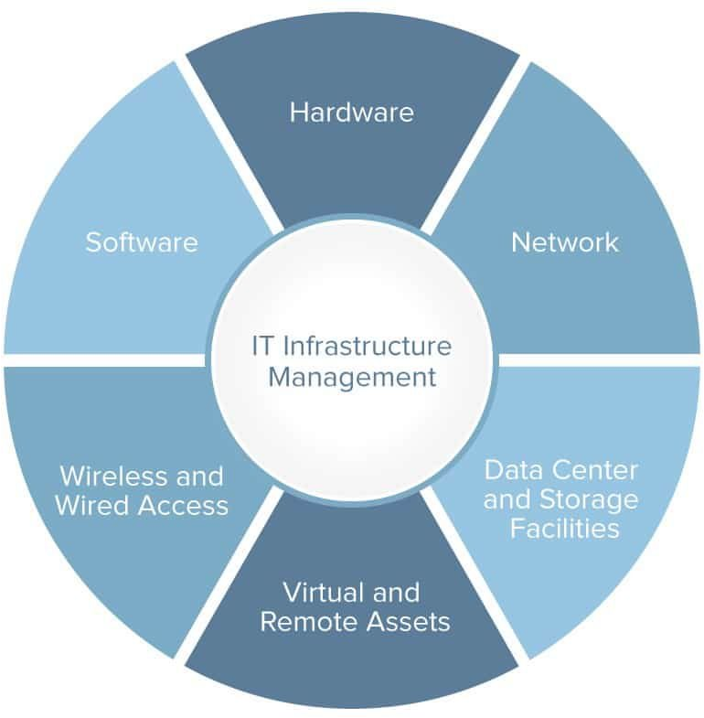
Career and Professional
Achievements
Academic Journey
Pursuing a Bachelor of Business Information Technology at Dedan Kimathi University, with a focus on computer programming.
Professional Projects
I developed a remotely accessible greenhouse integrating IoT sensors, and collaborated on a project with industry partners to solve real-world challenges.

Slide 7


Challenges and Adversities
Transition to High School
Struggled to adapt to rigorous demands and heightened expectations
Experienced a signiﬁcant drop in grades, leading to self-doubt
Overcame challenges through dedication and support from friends
Impact of COVID-19 Pandemic
Faced disruption in education with school closures
Adapted to online learning environment and leveraged digital resources
Achieved a B grade in KCSE, showing my resilience and perseverance

Slide 8
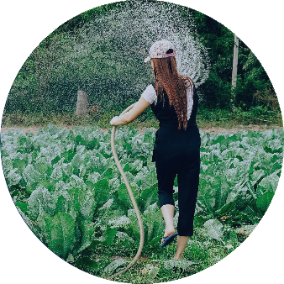

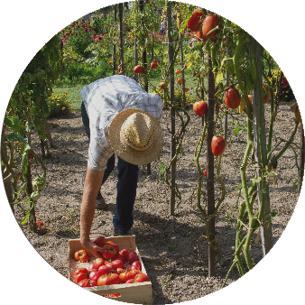
Passions, Hobbies, and Interests
Graphic Design
Culinary Arts
Dance and Music
I enjoys crafting digital illustrations and branding materials, blending artistry with technical skill.
I love experimenting with new recipes and hosting dinner parties, exploring diverse culinary traditions.
I ﬁnd joy in dance, particularly Afrobeats and Amapiano, I have a deep appreciation for various music genres.

Slide 9


Relationships and Friendship
Early Friendships
In childhood, I formed deep bonds with her sisters, Evelyne and Petra, who were my ﬁrst playmates and role models. These relationships provided a foundation of support and love.
School Companions
At Mount Sinai CMI School and Nakuru Girls High School, I developed signiﬁcant friendships with peers like Octavia, Annjoy, and Hadassah. These friends offered solace and motivation through academic pressures.
Evolving Connections
Over time, my relationships have grown, reﬂecting my personal development. My friendships have been crucial in shaping my identity, providing empathy, support, and a sense of belonging.

Slide 10


Identity and Cultural Background
Kikuyu Heritage
Rooted in Ndindiruku village, Kirinyaga County, my Kikuyu heritage is intertwined with family stories, traditions, and values passed down through generations.
Inﬂuential Grandparents
Grandparents Jinaro Kabui and Teresia Wambui have played a central role in my cultural education, sharing wisdom and stories that connected me to my roots.
Family Traditions
Cultural practices included family meals, storytelling, and traditional brewing of muratina, fostering a deep sense of community and belonging.
Cultural Identity
My Kikuyu culture, with its emphasis on resilience and communal spirit, continues to guide my values and actions in modern life.

Slide 11

Thank you.

